Slide 1
Customer Analytics - Segmentation of the Customer Base and Behavioral Profiling.
Faculty of Computer Science
Data Science and
Business Analytics
Moscow
2025
Submitted by the Students:
Kokorina Margarita Vitalievna group #БПАД221
Lazareva Ekaterina Nikolaevna group #БПАД221

Slide 2
The Purpose and Objectives of the Work
Data Science and
Business Analytics
Segmentation of the Customer Base and Behavioral Profiling
The Purpose and Objectives of the Work
The purpose of the work: To study data quality, build visual analytics on key business indicators, and create a customer showcase for subsequent behavior analysis. As part of the project, it is necessary to identify possible errors in the data, define filters for purchased goods and orders, and prepare a structured CSV file for customers with basic metrics.
Objectives of the work:
Checking data for omissions, duplicates, anomalies, and incorrect values;
Formation of consolidated visual analytics by categories, regions, and clients;
Building data storefronts for segmentation;
Segmentation of the client database.

Slide 3
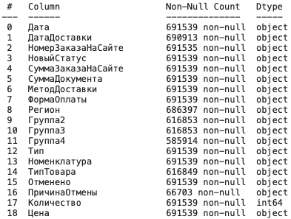
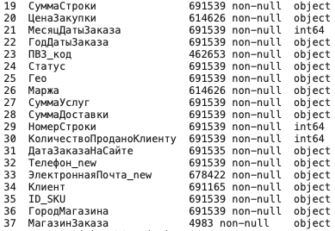
Data Research
Data Science and
Business Analytics
Segmentation of the Customer Base and Behavioral Profiling
Analysis of existing solutions

Slide 4
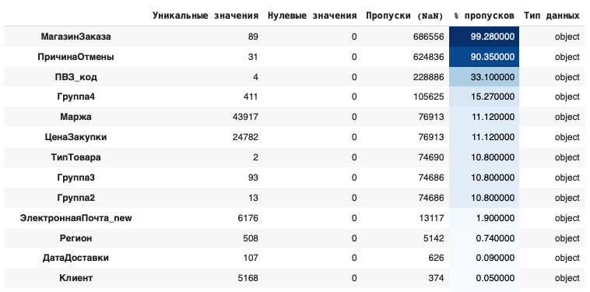
Data Research
Data Science and
Business Analytics
Segmentation of the Customer Base and Behavioral Profiling
Data Research
A critically high level of omissions is observed in the following signs:
МагазинЗаказа — 99.28% of passes. Such a column has no analytical value in its current form and must be deleted;
ПричинаОтмены is 90.35% of passes. It can be considered as a categorical indicator only for cancellation analyses;
ПВЗ_код — 33.1% of passes. Values are missing in a third of cases, partial imputation or filtering is possible;

Slide 5
Data Research
Data Science and
Business Analytics
Segmentation of the Customer Base and Behavioral Profiling
Data Research
Moderate absences (10-15%):
Группа4, Маржа, ЦенаЗакупки — omissions of the order of 11-15%. These signs need to be cleaned up because they are critical for revenue and profit calculations.
Low pass rate (<2%) for:
ЭлектроннаяПочта_new, Регион, ДатаДоставки, Клиент are acceptable and can be processed losslessly.

Slide 6
Data Cleaning
Data Science and
Business Analytics
Segmentation of the Customer Base and Behavioral Profiling
Data Cleaning
Data quality metrics have been calculated and visualized: the number of unique values, zeros, omissions, and their proportion for each attribute;
The numerical signs are of the correct type: int and float (by clearing lines and replacing commas with dots);
Removed signs with an excessive number of omissions (for example, the Order Store);
The string characters are lowercase and cleared of unnecessary spaces for consistency;
Basic data filtering has been performed, and obvious duplicates and irrelevant records have been eliminated.

Slide 7
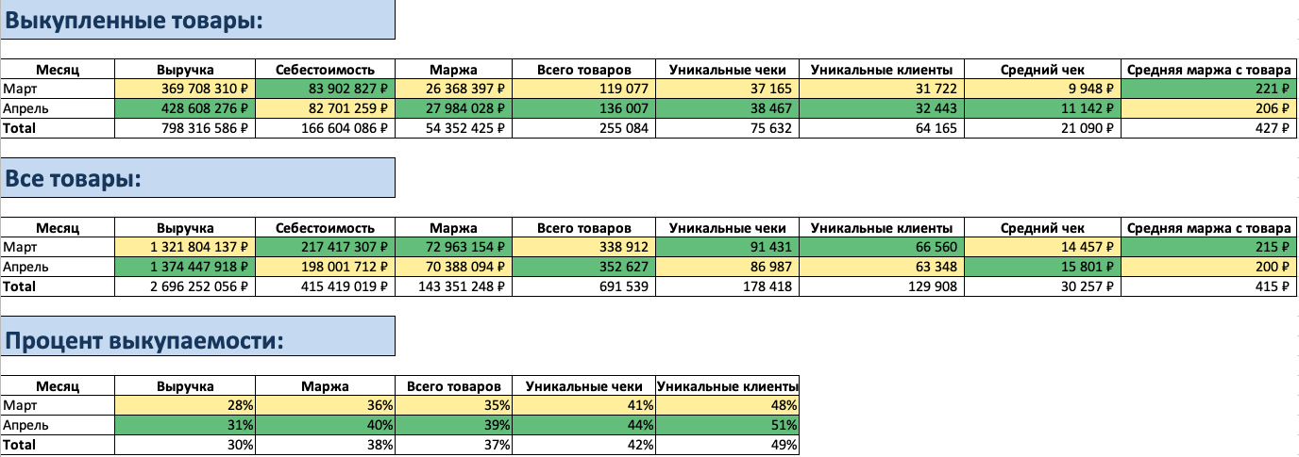
Summary Tables for Orders
Data Science and
Business Analytics
Segmentation of the Customer Base and Behavioral Profiling
Summary Tables for Orders

Slide 8
Assembling a Customer Showcase for Segmentation
Data Science and
Business Analytics
Segmentation of the Customer Base and Behavioral Profiling
Data Showcase
The customer showcase was built on the basis of data on orders, products, payment, delivery, and geography. The key identifier of the client is a phone number (Телефон_new).
Key fields and indicators of the showcase:
Number of unique orders;
Average receipt and average order line amount;
Average number of items per order;
Order shares by:
payment methods (Форма Оплаты);
by Region (Регион_из_населения_по_городу);
product categories (Группа 2);
Percentage of cancelled orders;
Percentage of pickup orders;
The percentage of refunds in monetary terms.

Slide 9
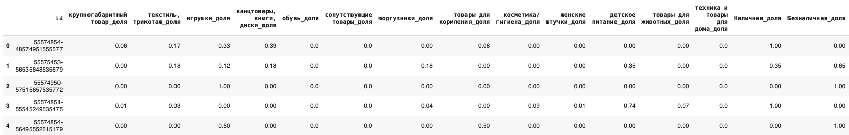
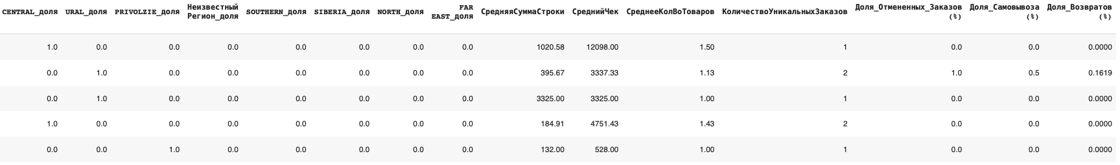
Assembling a Customer Showcase for Segmentation
Data Science and
Business Analytics
Segmentation of the Customer Base and Behavioral Profiling
Data Showcase
The final customer showcase for segmentation contains 114448 rows and 31 columns.

Slide 10
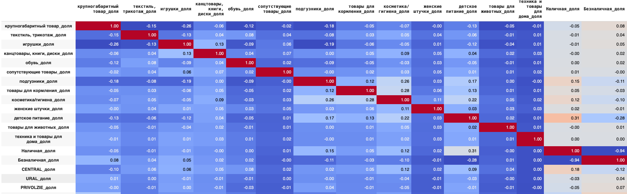
Correlation of Data
Data Science and
Business Analytics
Segmentation of the Customer Base and Behavioral Profiling
Correlation of Data
The Безналичная_доля and Наличная_доля columns correlate with each other with the value 0.94, we delete the column Наличная_доля.

Slide 11
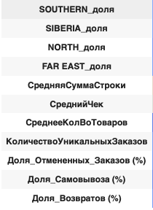
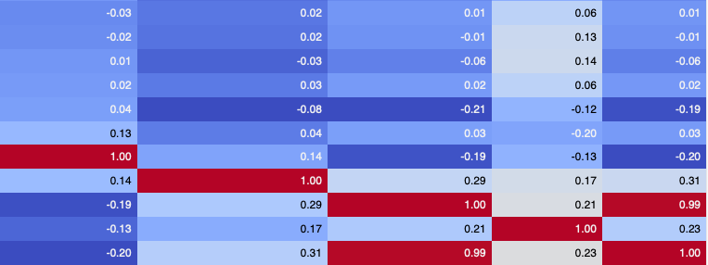
Correlation of Data
Data Science and
Business Analytics
Segmentation of the Customer Base and Behavioral Profiling
Correlation of Data
The column Доля_Отмененных_Заказов and the column Доля_Возвратов correlate at 0.99. So, here we delete column Доля_Отмененных_Заказов.

Slide 12
Clusterization
i. The K-means algorithm
Data Science and
Business Analytics
Segmentation of the Customer Base and Behavioral Profiling
Clusterization. K-means Algorithm
K-means is an unsupervised learning algorithm that splits data into k clusters based on the proximity of points to centroids. Its task is to minimize the intracluster distance so that the points inside the cluster are as similar to each other as possible.
The main steps of the algorithm:
Initialization: random selection of k cluster centers (centroids).
Point assignment: Each point refers to the nearest center (by Euclidean distance).
Recalculation of centers: for each cluster, a new center is recalculated — the average value of all points in the cluster.
Repeat steps 2-3 until the centers stop changing (or a maximum of iterations is reached).
The result: each point belongs to one of the k clusters, and the cluster centers are their "averages".

Slide 13
Advantages and Disadvantages of the K-means Algorithm
Data Science and
Business Analytics
Segmentation of the Customer Base and Behavioral Profiling
K-means Algorithm.
Advantages and Disadvantages
Advantages:
A simple and fast algorithm (effective on large amounts of data);
It works well on spherically distributed data;
It is easy to interpret the results (centroids = typical objects).
Disadvantages:
You need to set the number of clusters k in advance;
It is sensitive to outliers and feature scales (therefore normalization is required);
It does not cope well with clusterization of complex shapes (for example, rings, linear chains);
The result may depend on the initial initialization of the centers.

Slide 14
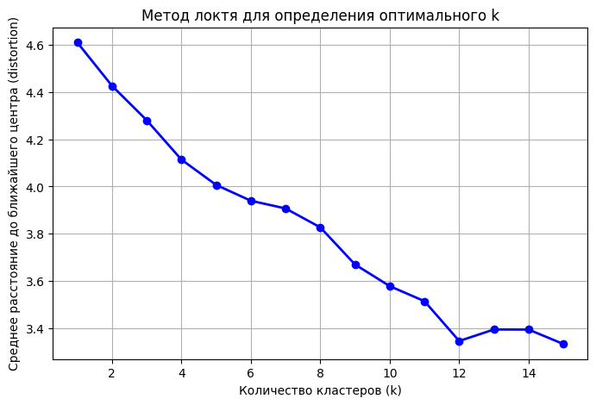

Choosing the Number of Clusters for the K-means Model
Data Science and
Business Analytics
Segmentation of the Customer Base and Behavioral Profiling
K-means Algorithm. The Elbow Method
Running clusterization for a different number of clusters k
For each k, we calculate the sum of the intracluster distances (called inertia or distortion):
Next, it is necessary to plot the dependence "inertia vs. k".
Finally, looking for the "breaking point" — the elbow: this is the value of k, after which the decrease in error slows down dramatically.
Here, the most obvious "breaking point" is 5, 9 and 12.

Slide 15
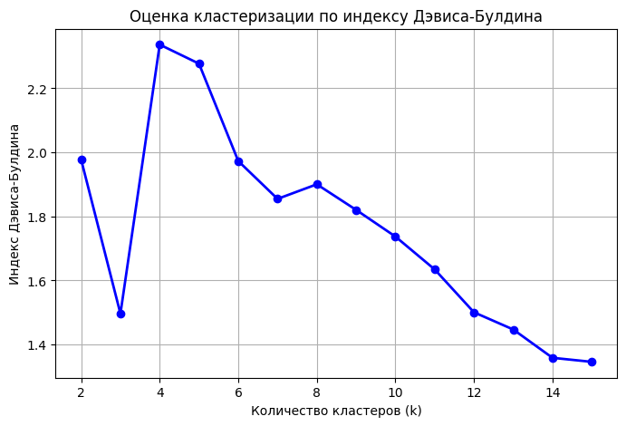
Evaluation of Clusterization Quality. Davis-Buldin Index
Data Science and
Business Analytics
Segmentation of the Customer Base and Behavioral Profiling
K-means Algorithm. Davis-Buldin Index
The Davis-Buldin index is a metric for evaluating the quality of clustering. It measures how well clusters are separated from each other and how compact they are inside.
The index is calculated as the average value of the maximum ratio between the intra-cluster spread and the distance between clusters.
The lower the index value, the better the clustering: clusters are dense inside and far from each other.
As the minimum on the graph is the optimal number of clusters, respectively, here it is 15.

Slide 16
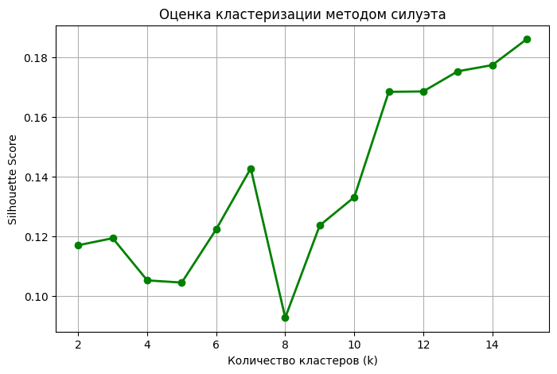
Evaluation of Clusterization Quality. Silhouette Coefficient
Data Science and
Business Analytics
Segmentation of the Customer Base and Behavioral Profiling
K-means Algorithm. Silhouette Coefficient
For each point, the silhouette coefficient is calculated, which takes a value from -1 to 1. A value close to 1 means that the point fits well into its cluster and is far from its neighbors.
A value of about 0 indicates uncertainty (a point on the cluster boundary), and a negative value indicates a possible clustering error.
The average silhouette value for all points helps determine the optimal number of clusters: the higher it is, the better the groups are separated.

Slide 17
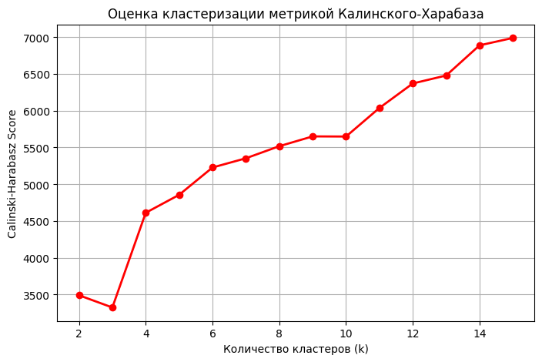
Evaluation of Clusterization Quality.
Kalinski-Kharabash Index
Data Science and
Business Analytics
Segmentation of the Customer Base and Behavioral Profiling
K-means Algorithm.
Kalinski-Kharabash Index
The Kalinski-Kharabash index evaluates the quality of clustering based on the ratio between intercluster and intracluster variance. It shows how well the clusters are separated from each other and how compact they are inside.
The higher the value of this index, the better clustering is performed: objects within the cluster are close to each other, and between clusters they are well separated.
This index is especially useful when choosing the optimal number of clusters — the maximum value indicates the best partitioning.

Slide 18
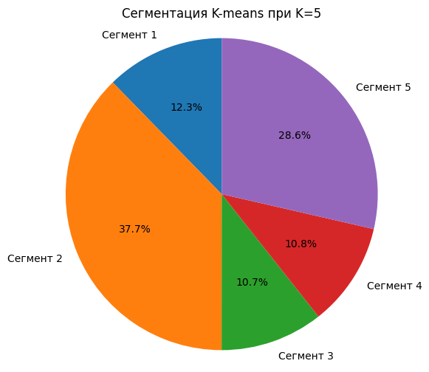
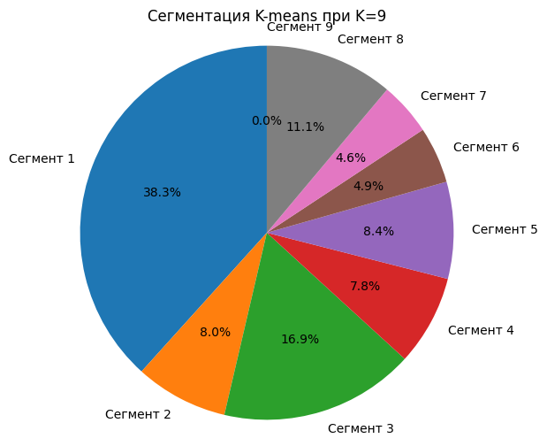
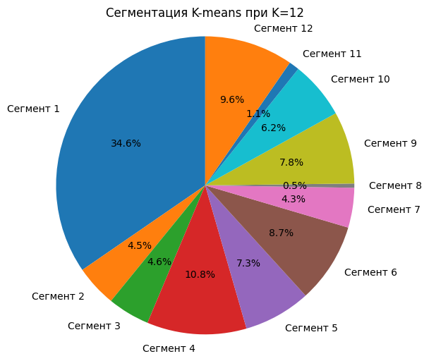
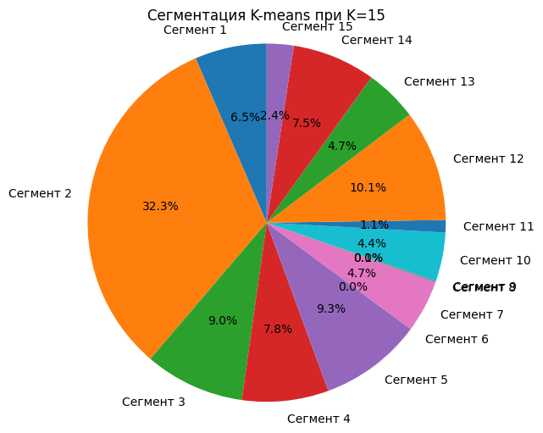
Distribution for Clusters 5, 9, 12 and 15
Data Science and
Business Analytics
Segmentation of the Customer Base and Behavioral Profiling
K-means segmentation
Segmentation into 12 clusters is the most balanced option because of:
1) No segment occupies an excessively large share (as, for example, 38.3% on the graph with K=9 or 37.7% on K=5).
2) There are also no segments with zero value (as in the case of K=9, K=15)
The distribution between the segments is fairly even, most clusters occupy from 4% to 10%, which indicates a more uniform structure of customer groups.

Slide 19
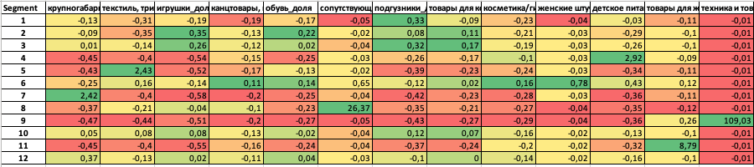
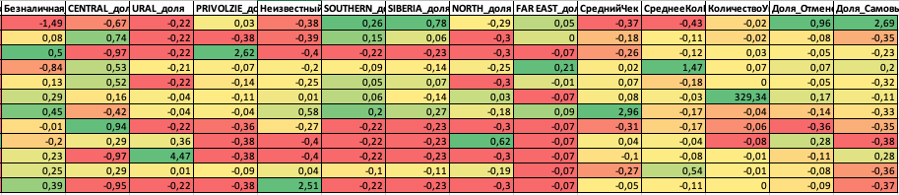
K-means Segment Analysis
Data Science and
Business Analytics
Segmentation of the Customer Base and Behavioral Profiling
K-means segmentation
Segment 6 stands out strongly in terms of the number of purchases, which may indicate a specific data or anomaly. Segment 9 is active in the equipment category and shows a high average receipt, but also has a high percentage of cancellations — this is a potentially problematic group. Segment 12 looks to be the most balanced in all indicators.

Slide 20
Clusterization
ii. Expectation-Maximization Algorithm
Data Science and
Business Analytics
Segmentation of the Customer Base and Behavioral Profiling
Clusterization.
Expectation-Maximization Algorithm
An iterative method for estimating parameters in probabilistic models with hidden variables.
Steps:
E-step (Expectation): Estimate the expected value of the log-likelihood, given current parameters and observed data.
M-step (Maximization): Update parameters by maximizing this expected log-likelihood.
This process repeats until convergence.
Used in clustering (e.g., Gaussian Mixture Models) and other problems involving incomplete data or latent structure. Helps uncover hidden patterns by iteratively refining estimates.

Slide 21
Advantages and Disadvantages of Expectation-Maximization Algorithm
Data Science and
Business Analytics
Segmentation of the Customer Base and Behavioral Profiling
Clusterization.
Expectation-Maximization Algorithm
Advantages of EM Algorithm:
Allows modeling of clusters with various shapes and sizes (e.g., elliptical clusters, unlike K-means' spherical assumption).
Provides "soft" assignment of points to clusters (each point has a probability of belonging to each cluster, rather than a hard assignment).
Effective when dealing with missing data or latent variables.
Disadvantages of EM Algorithm:
More computationally intensive than K-means, especially for large datasets or many clusters.
Sensitive to initial initialization, potentially converging to local optima rather than the global optimum.
Requires pre-specifying the number of components (clusters), similar to K-means.

Slide 22
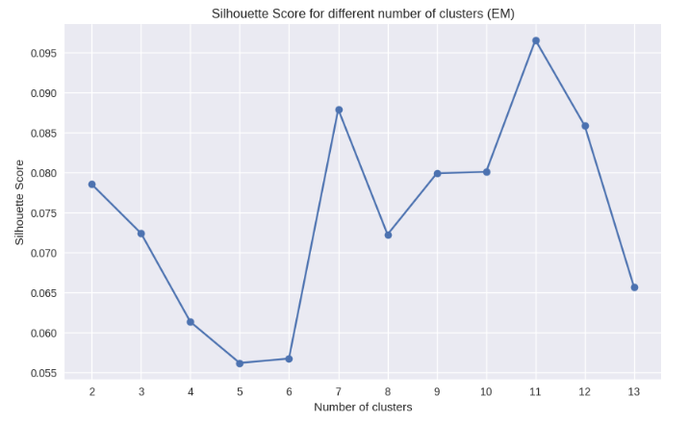
Optimal Number of Clusters: Silhouette Score
Data Science and
Business Analytics
Segmentation of the Customer Base and Behavioral Profiling
Expectation-Maximization Algorithm. Silhouette Score
The graph illustrates the change in Silhouette Score as the number of clusters varies.
The values enclosed in red boxes (k=7 and k=11) correspond to the highest Silhouette Scores, which can serve as an indicator for the most suitable number of clusters for this EM clustering model.

Slide 23
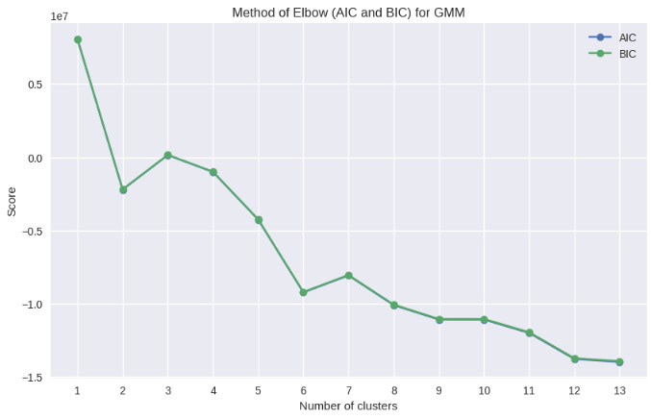
Method of Elbow (AIC and BIC)
Data Science and
Business Analytics
Segmentation of the Customer Base and Behavioral Profiling
. Expectation-Maximization Algorithm. Method of Elbow (AIC and BIC)
The graph displays the AIC and BIC scores for different numbers of clusters.
While the "elbow" is less pronounced, the red box indicates that beyond 13 clusters, there is minimal additional benefit in terms of model fit, suggesting that further increasing the number of clusters might lead to overfitting without substantial gain.

Slide 24
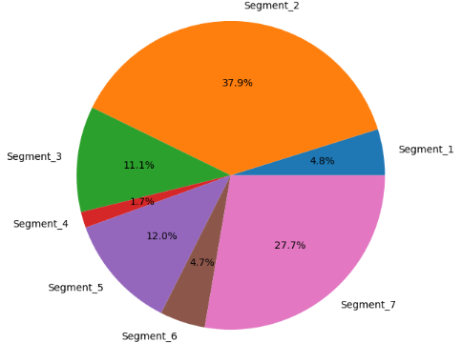
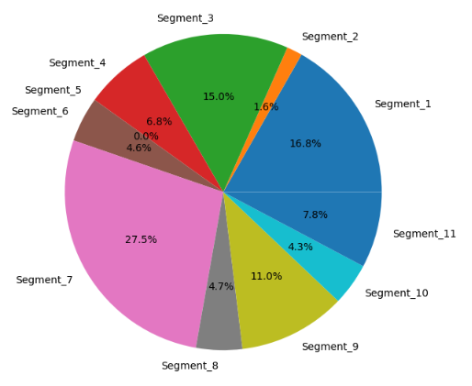
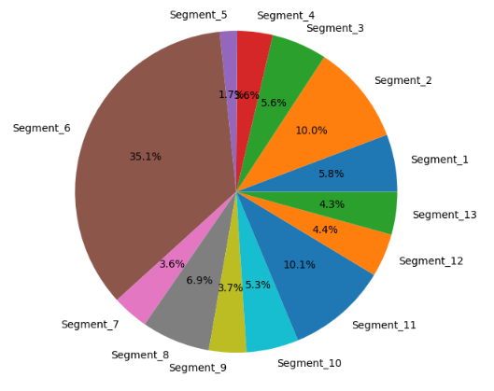
Distribution for Clusters 7, 11, 13
Data Science and
Business Analytics
Segmentation of the Customer Base and Behavioral Profiling
Distribution for Clusters 7, 11, 13
7 clusters
11 clusters
13 clusters
Large segments (Segment_2 — 37.9%, Segment_7 — 27.7%) dominate, indicating over-aggregation. Small segments are lost, detail is weak.
The distribution is more balanced, but there are still large segments (Segment_8 — 21.7%, Segment_2 — 19.8%), which can interfere with point segmentation.
The most even distribution: only one dominant segment

Slide 25
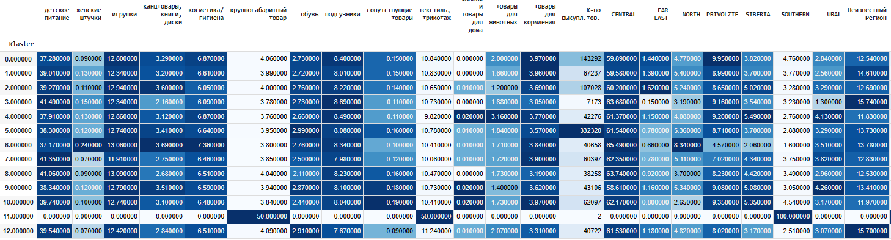
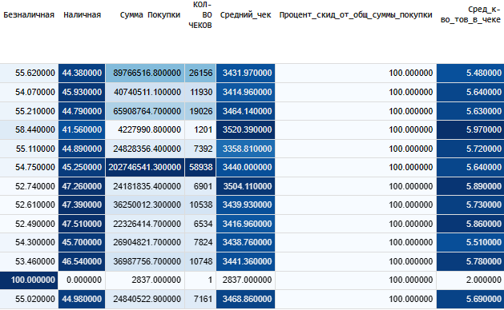
13 cluster pivot table analysis
Data Science and
Business Analytics
Segmentation of the Customer Base and Behavioral Profiling
13 cluster pivot table analysis
Segmentation into 13 clusters revealed clear differences in consumer behavior and preferences. Some segments (Cluster 0 and 1) account for the bulk of sales, while others (Cluster 9) have a high average check and niche interests. There are also pronounced regional characteristics, which are important to consider when targeting. This level of detail provides the basis for personalized strategies.

Slide 26
Conclusion
Data Science and
Business Analytics
Segmentation of the Customer Base and Behavioral Profiling
Conclusion
Data was cleaned and a customer showcase was built using key behavioral metrics.
Different clustering methods (K-means, EM) were evaluated, with 12 (K-means) and 13 (EM) clusters showing the best results.
Segmentation revealed clear differences in customer behavior and regional patterns.
These insights enable personalized marketing strategies and more effective customer base management.

